Slide 1
SALES ANALYSIS
Using Superstore dataset

Slide 2
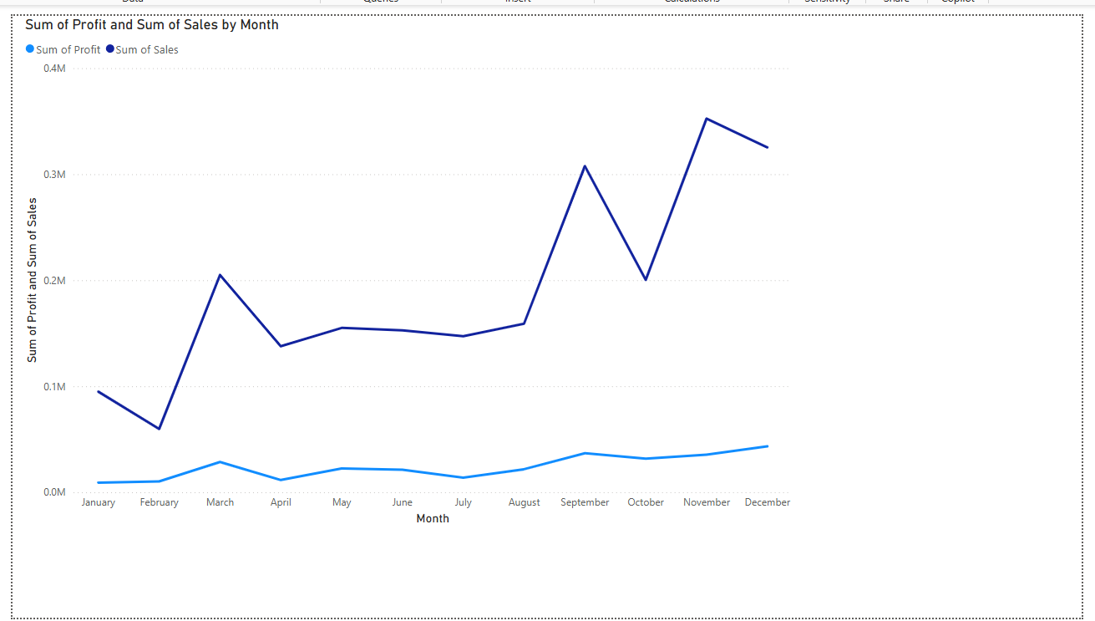
Profit and Sales Over the Year Using Line chart

Slide 3
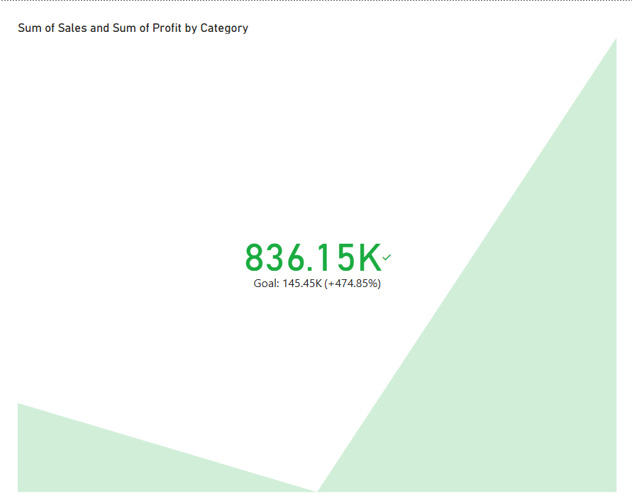
Profit and Sales Over Cateogory using KPI

Slide 4
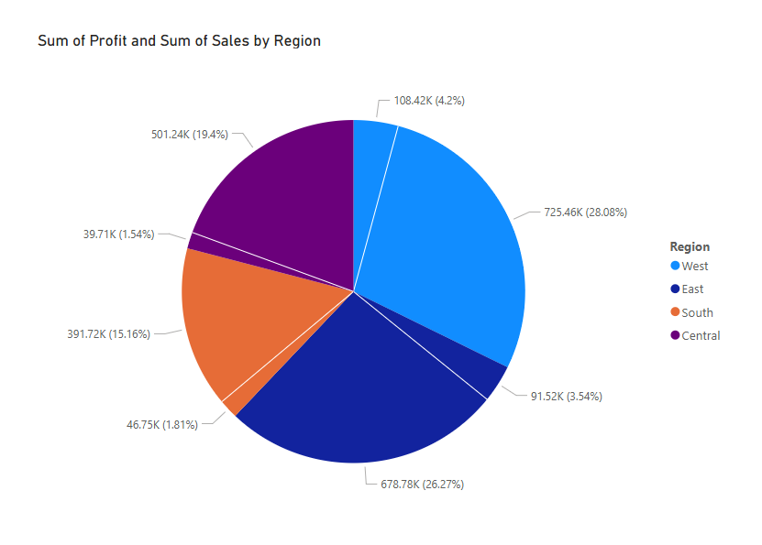
Profit and Sales Over Region using Pie Chart

Slide 5
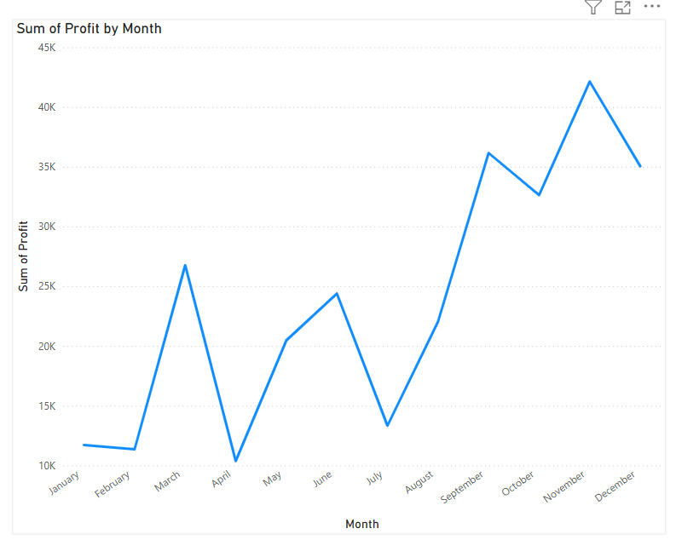
Profit Over Month using Line Chart

Slide 6
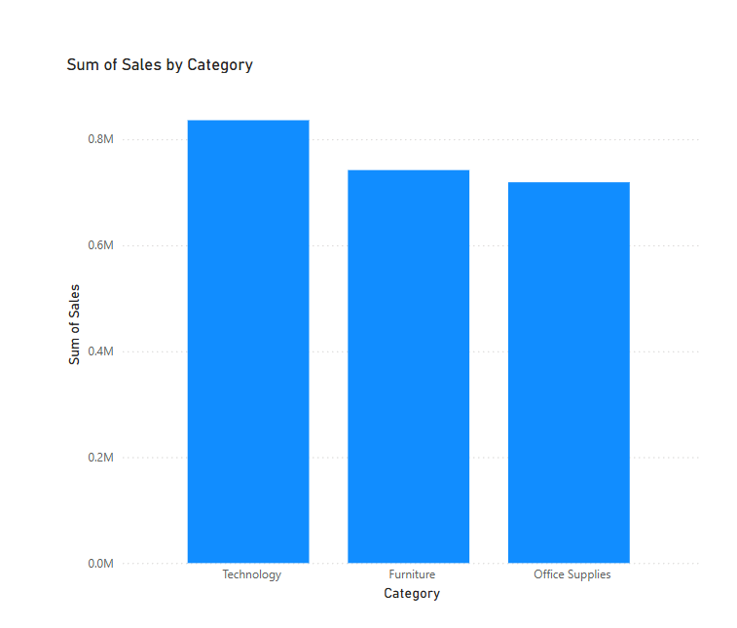
Sales Over Category using Bar Chart

